Slide 1
Linear Models
Understanding their role in Data Mining

Slide 2
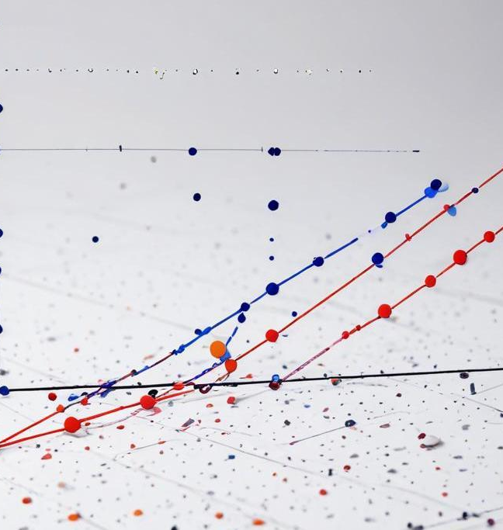
Introduction
Linear models play a crucial role in data mining by providing simple yet powerful techniques for predicting outcomes and understanding relationships between variables.

Slide 3
Overview
01

Slide 4
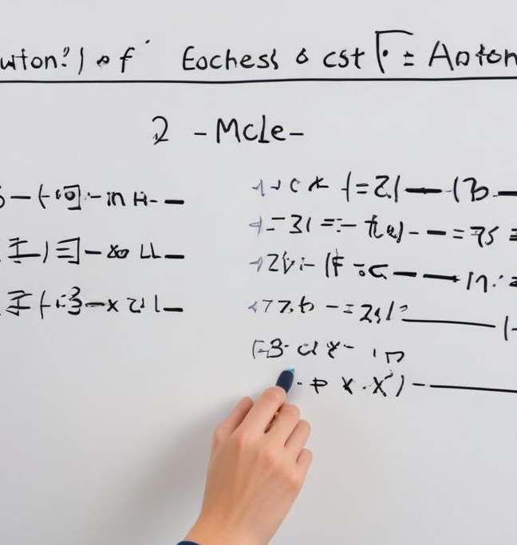
Definition of Linear Models
Linear models are mathematical representations of relationships between variables. They assume that the relationship can be expressed as a linear equation, allowing for straightforward interpretation of coefficients and predictions.

Slide 5
Importance in Data Mining
Linear models are foundational in data mining as they are easy to interpret and implement. They are used for predictive analysis, feature selection, and understanding the impact of independent variables on dependent outcomes.

Slide 6
Types of Linear Models
Common types of linear models include Simple Linear Regression, Multiple Linear Regression, and Ridge Regression. Simple Linear Regression models the relationship between two variables, while Multiple Linear Regression extends this by incorporating multiple predictors. Ridge Regression adds regularization to mitigate overfitting, enhancing model performance.

Slide 7
Applications
02

Slide 8
Predictive Modeling
Predictive modeling uses linear models to forecast outcomes based on historical data. By identifying patterns in data, these models can provide insights into future trends, helping businesses and researchers make informed decisions.

Slide 9

Regression Analysis
Regression analysis is a statistical method to estimate the relationships among variables. The core idea is to model the dependent variable as a function of one or more independent variables, allowing analysts to discern the influence of these predictors.

Slide 10
Classification Tasks
Linear models can also be utilized in classification tasks, where the goal is to categorize data points into discrete classes. Techniques like Logistic Regression are popular for binary classifications, applying the linear model to predict probabilities of outcomes.

Slide 11

Conclusions
Linear models are essential tools in data mining, offering straightforward methods for both prediction and analysis. Their simplicity, interpretability, and effectiveness make them widely applicable across various fields.

Slide 12
Thank you!
Do you have any questions?
www.yourwebsite.com
+91 620 421 838

